Slide 1


OmniRAG on Azure Cosmos DB
(Graph+Vector+Raw)
Aleksey Savateyev Data & AI GBB
Chris Joakim Data & AI GBB

Slide 2


Baseline RAG (Retrieval Augmented Generation)
Ingest Raw Data
(files, objects, etc.)
Query / Command
Model Input
Output
(completion)
System Prompt
Chunking
Generate
embedding
User prompt
Query / command
Generate
embeddings
Similarity
Search
Retrieved Data
Azure OpenAI
Persist chunks and embeddings
Vector DB
Rank and curate chunks

Slide 3
Have you ever seen this?
You: how many bikes of each type do you have in your shop?
You: what is total order amount for the road bikes with white frame?
You: how much was my last transaction?
Bot: there are two bikes – one mountain bike and one road bike
Bot: The records provided don’t contain this information
Bot: Looks like your last purchase order made a year ago was for $100
Too few records and no aggregates fetched from the vector store to answer the question
No aggregates fetched from vector store
Stale and unsorted data fetched from vector store

Slide 4
Baseline RAG is not enough!
Only contains summary of the original source data without aggregates-> lower accuracy of AI solution
Leads to using all available model context window for (possibly irrelevant) custom data -> higher cost for inferencing
Requires generating embeddings on the entire dataset -> higher cost for compute/storage
Requires pre-population of semantic index (facets/column-level stats) by guessing what the questions will be -> lower accuracy, higher costs for search engine

Slide 5
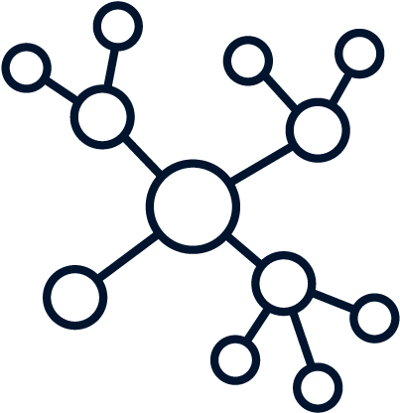
Introducing OmniRAG
Ingest Raw Data
(files, objects, etc.)
Query / Command
Model Input
Output
(completion)
Intent Detection
Query / Command
Chunking
Generate embedding
NL–to-Query Language
Main User/System Prompts
Convert to database records
Similarity Search
In-memory Graph
Azure OpenAI
Query / Command
Database (+vector)
Retrieved Data

Slide 6




Scenario guidance Azure AI Search vs Azure Databases+Vector Search vs Omni-source Approach
Azure AI Search
Vector Search in Azure Databases
OmniRAG (Graph+Vector+Raw)
Messaging tagline
“Best similarity search and support for existing data sources: highest number of supported data sources and the best semantic and hybrid search capabilities out of the box”
Key value proposition
Best out of the box semantic and hybrid search
When to use
Relevance: offers most relevant results in similarity search (via ranking and hybrid search) and best support for variety of data sources
Messaging tagline
“Keep your data where it is: native, built-in vector search capabilities at scale”
Key value proposition
Operational efficiency: no data movement required
When to use
Operational impact: if you do not want to or can’t move your data outside of your operational database
Messaging tagline
“Best relevance and best performance: highest quality results and highest degree of customizability for optimal cost and performance”
Key value proposition
Highest quality results at lowest cost
When to use
Relevance: offers most relevant results (via user intent detection and query routing) and best customizability at lowest price point

Slide 7
Customer use cases
Azure AI Search
Vector Search in Azure Databases
OmniRAG (Graph+Vector+Raw)
Financial and/or insurance document analysis: search for specific/precise information like product codes, people names, etc.
Document workflow support : search vast amounts of indexed data bases on similarity or pattern
Exploration of variety of indexed data from numerous supported data sources (data lakes, databases, file storages)
Transactional applications such as eCommerce with real-time inventory data
Chat history for conversational context and prompt engineering
Semantic cache for curated FAQ and LLM interaction optimization
Generative customer support / contact center: pull customer records, screenshots, transactional data and personalized recommendations
Non-linear workflows based on detected user intent and data retrieval orchestration: agents, expert systems, etc.
AI-powered knowledge graphs (data lineage, document workflow tracking, etc.)
Intelligent digital twins (AI-powered digital representation of complex real-world relationships)

Slide 8
CosmosAIGraph as OmniRAG implementation
What is it providing?
OmniRAG pattern reference implementation using knowledge graph/vector database/raw database
Semi-automatic knowledge graph generation from existing data store (Cosmos DB, flat files, etc.)
User intent detection (strategy builder) powered by AI
Scalable knowledge graph database/index with in-memory model (such as RDF) and fast persistent store for graph and raw data (Cosmos DB)
“Natural language to graph query” generator
powered by AI with optional feedback loop

Slide 9
CosmosAIGraph is based on RDF Technology
Resource Description Framework (RDF)
A set of W3C standards
Typically used for Knowledge Graphs
Web Ontology Language (OWL)
An XML syntax to define the Classes and ObjectProperites of your graph
Think of these as the Entities and Relationships, or your graph schema
Triples
A graph building block - a tuple of ( subject, predicate, and object )
For example: ( Chris → works_at → Microsoft )
An RDF graph consists of many of these simple triples, conforming to the ontology
SPARQL 1.1
The query language. Similar to SQL, simpler than Gremlin, Cypher
Rdflib
A python library that implements an in-memory RDF graph

Slide 10
Graph Search in CosmosAIGraph
Design and load your Cosmos DB MongoDB vCore account
Use typical NoSQL design patterns
Define your OWL graph schema
Load the in-memory RDF database
Read only the necessary attributes of the Cosmos DB documents
The in-memory graph is mutable, but typically static
Query the in-memory RDF database with SPARQL
It’s very fast because it’s in memory
It’s low cost, because no vectorization is needed, and only open-source libraries are used.

Slide 11
Vector Search in CosmosAIGraph
“Vectorize” your data
Use the Azure OpenAI SDK with your Azure OpenAI service
Pass in a text value, receive back an “embedding” – an array of 1,536 floats
The embedding captures the semantic meaning of the text
Use the text-embedding-ada-002 or similar model in Azure OpenAI
Store that vector, along with document contents, in your vector database
https://learn.microsoft.com/en-us/azure/ai-services/openai/tutorials/embeddings
Vector Search
Pass in a vectorized query/command (i.e. embedding) as the argument to a search in the database
Receive N number of documents which match the given vector with semantic similarity
https://learn.microsoft.com/en-us/azure/cosmos-db/mongodb/vcore/vector-search

Slide 12
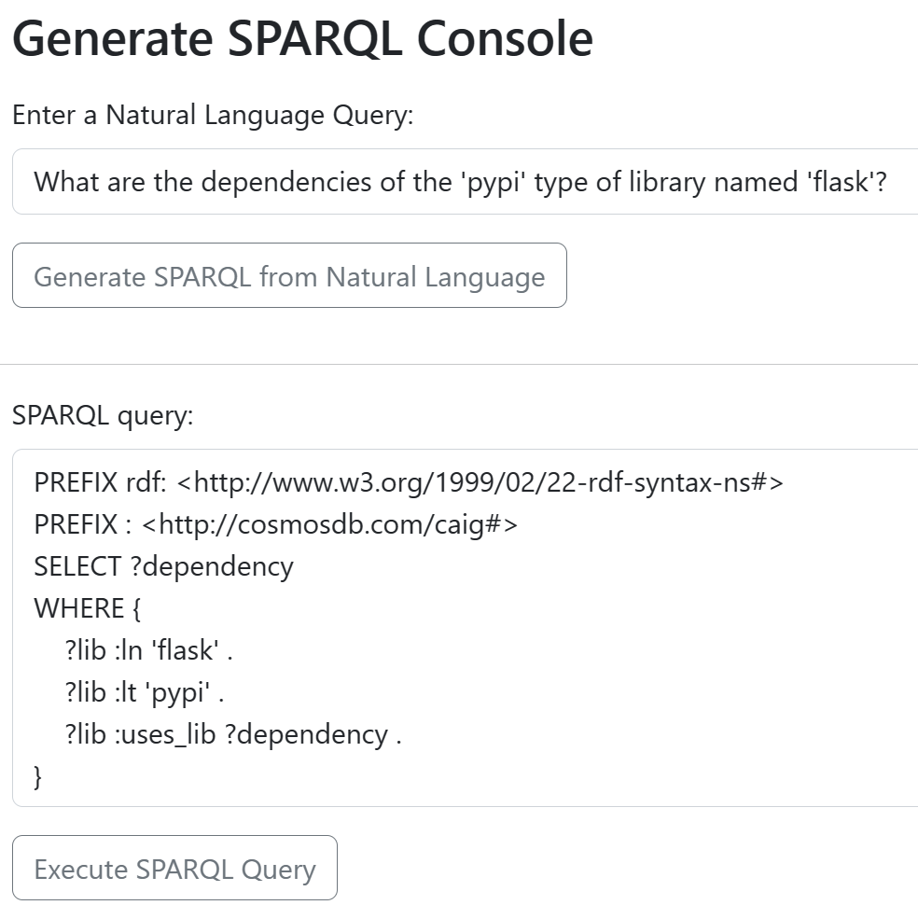
NL2SPARQL in CosmosAIGraph
Uses GPT-4o in Azure OpenAI
The OWL ontology is the “System Prompt”
The Natural Language is the “User Prompt”
The result is a working SPARQL query

Slide 13
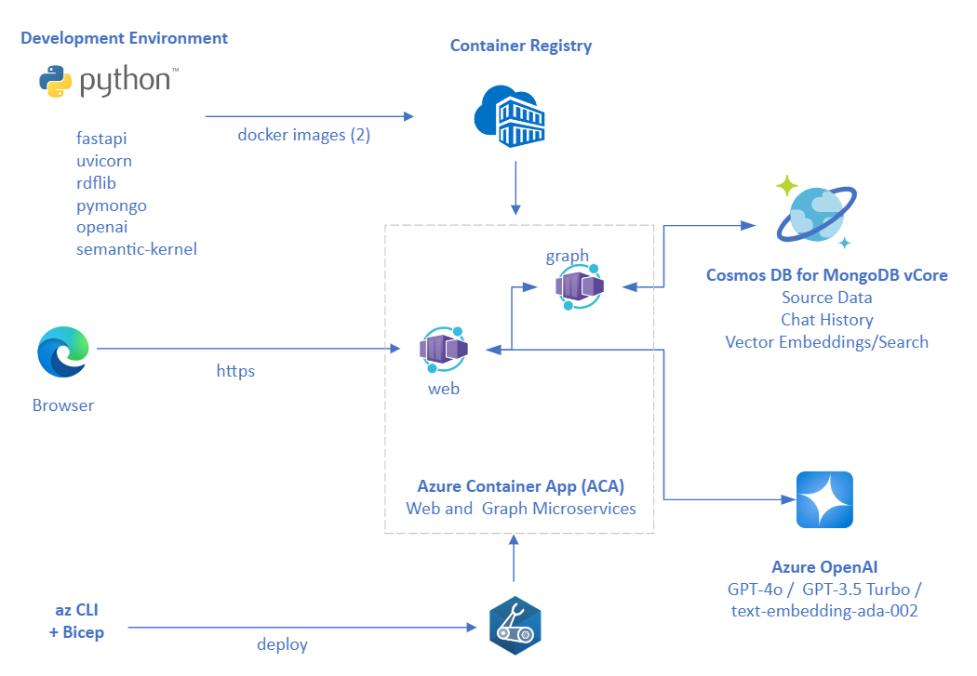
CosmosAIGraph Deployment Architecture

Slide 14


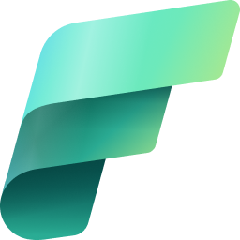






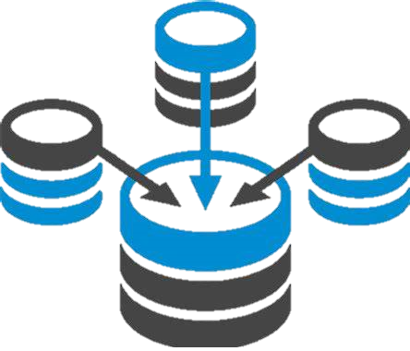


CosmosAIGraph Solution Architecture
Public GitHub repo: aka.ms/caig
Users
Analytics +
Semantic Layer
[Optional]
Source Data
CosmosAIGraph
Cosmos DB
Load triples+ ontology
4
Microsoft Fabric
Web/AI Microservice
(Python/FastAPI/D3.js)
Relational
Run generated SPARQL / Export results to JSON
9
11
[Fetch source]
Source Data
Embeddings
+ RDF Triples |
Ontology OWL
5
User prompt
6
Pass prompt/ completion
10
[Match vectors]
Azure AI Search
Business Analysts
Data Engineers
Data Scientists
Query/Graph Visualizer
In-memory Graph Microservice
(Python/rdflib/SK)
NoSQL
1
[Select data for graph]
2
[Generate
RDF graph]
Get user intent
(similarity search/ database query)
[Persist generated graph + ontology]
3
7
Data Factory
OLAP
Graph Generator
8
Generate SPARQL
12
Get completion for prompt graph
[+vector | raw] results
Streams
Azure OpenAI
(gpt-35-turbo)
Azure OpenAI
(gpt-4o)
Files/Blobs
Legend:
Primary Flow (hot path)
Background Flow (cold path)
Data Ingestion/Mirroring
[Optional actions]
1
User actions
2
Service actions

Slide 15
CosmosAIGraph Summary
It’s a reusable reference design and implementation. It’s not a product
It is built on the following:
Azure OpenAI service with industry-leading LLMs
Semantic Kernel – for pluggable and extensible orchestration
Cosmos DB for MongoDB vCore service, natively supporting vector search (IVF, HNSW)
RDF technologies – triples, OWL ontologies, SPARQL queries
In-memory graph (via rdflib) – for fast performance and low costs
Python 3 – rdflib, fastapi, pydantic, pymongo, semantic-kernel libraries
Designed as set of microservices
Deployed to Azure Container Apps with Bicep.

Slide 16
Call to Action!
Go to public repo aka.ms/caig and explore
Deploy it to your Azure subscription
Demo it to the customers and capture their feedback on OmniRAG and CosmosAIGraph

